Slide 1
Tool Sharing Website
Toolie
By:
Aparna Mandapaka
Kevin Gallardo
Sergey Mikhaylov
Natnael Dejene
Fiker Desta

Slide 2
What do we do?
We provide a platform to loan and borrow tools
Stop borrowing tools from big retail stores
See what tools your neighbors have and borrow those instead
Improved community relationships
Get the tools that you need faster
Notes:
Description and purpose of software system

Slide 3
Targeted Users
Neighbors – people who live in the same community and want to help each other by sharing resources
People on a budget
Renters – people who live in apartments or smaller homes and may not have the space to store tools
DIY enthusiasts – people who want to do home improvement projects
People that do not want to travel to or do business with big stores

Slide 4
Chosen Technical Platforms
MySQL
Relational Database
Java
Spring boot – host java code
Hibernate – Spring boot library to use on database
React
Map box
MUI core + CSS
Javascript

Slide 5
UML Sequence Diagram

Slide 6
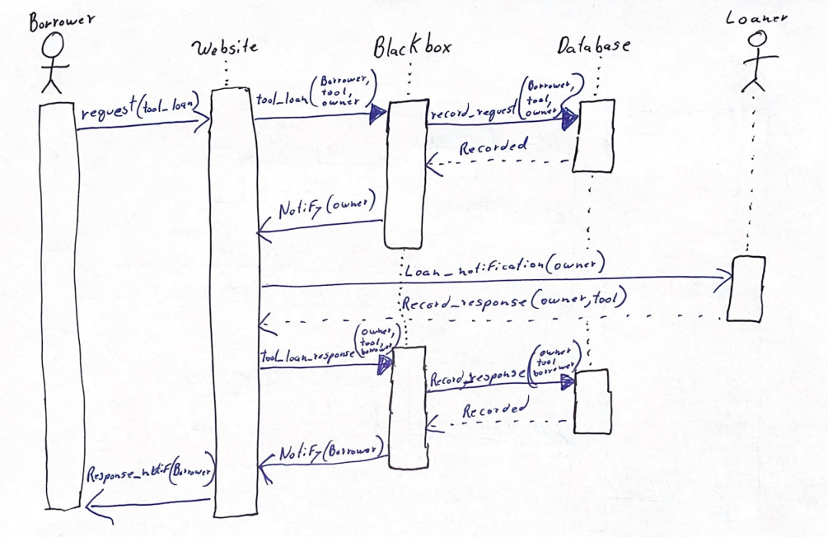
UML Sequence Diagram for tool borrowing/loan

Slide 7
UML Use Case diagrams

Slide 8
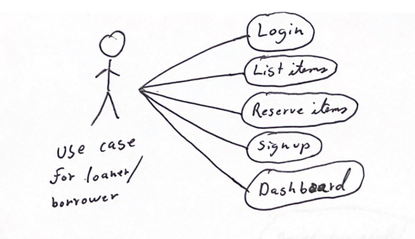

Slide 9
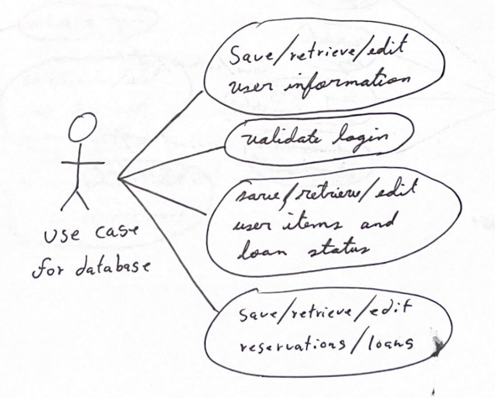

Slide 10
UML of Wireframe

Slide 11
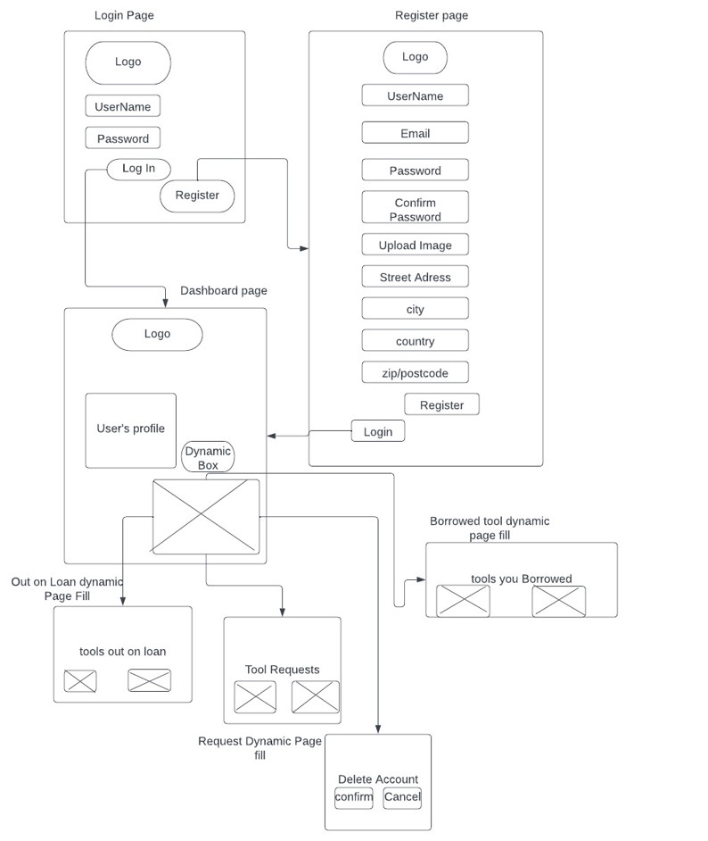

Slide 12
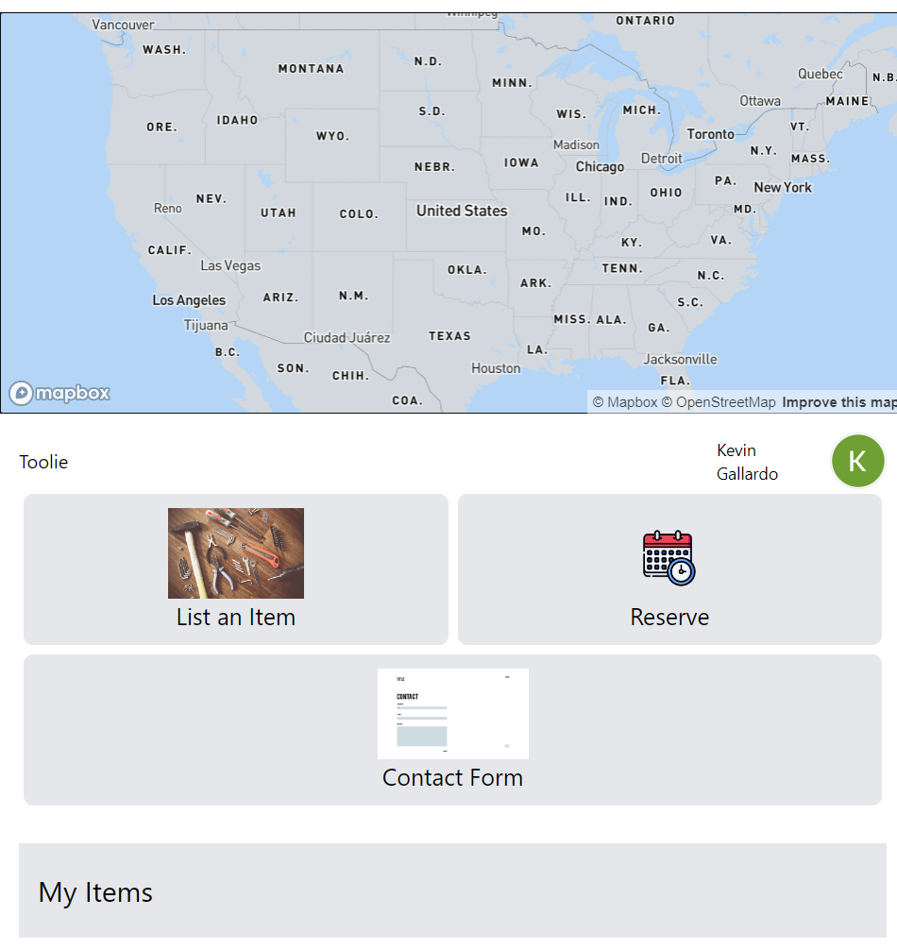
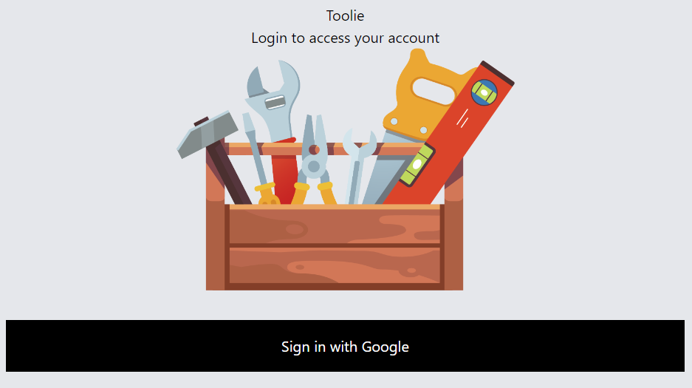
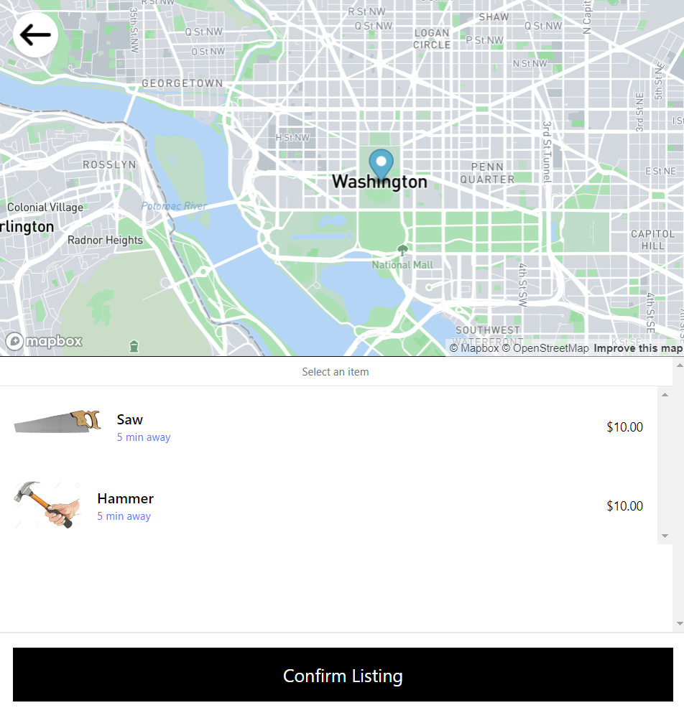
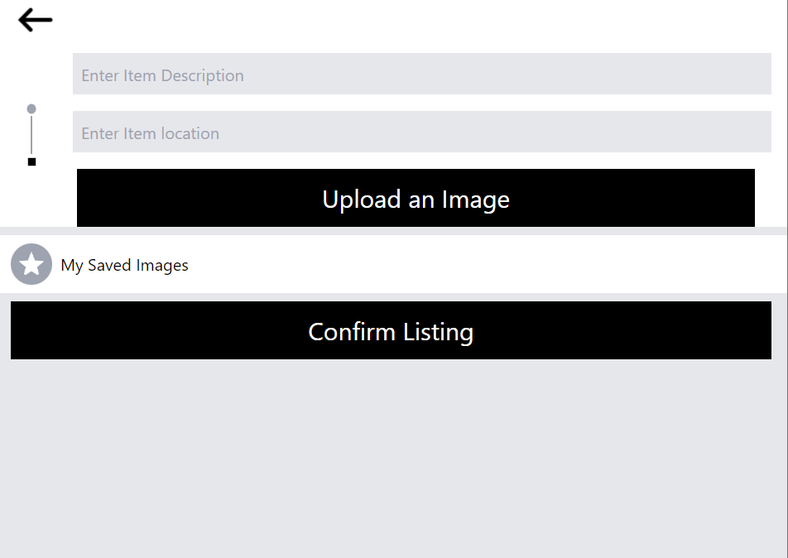
Process flow of HTML

Slide 13

THANKS!
Any questions?

